Slide 1
Basic Concept and Clinical Implication of PPG (Photoplethysmogram)
KSHNE 2022 Symposium
December 10th, 2022 10:15 ~ 10:30
이화여자대학교 의과대학 계림홀
Kwang-No Lee, MD, PhD
Department of Cardiology
Ajou University Hospital
Ajou University School of Medicine

Slide 2
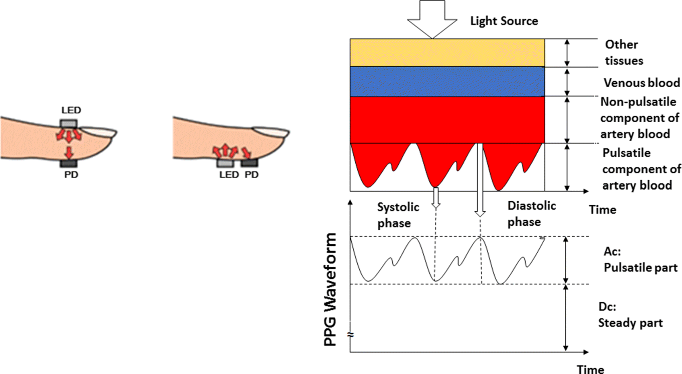
To Detect Blood Volume Changes in the Microvascular Bed
Challoner, 1979
Pulse oximeter, vascular diagnostics and digital beat-to-beat blood pressure measurement systems
Tamura T et al. Electronics. 2014; 3(2):282-302.

Slide 3
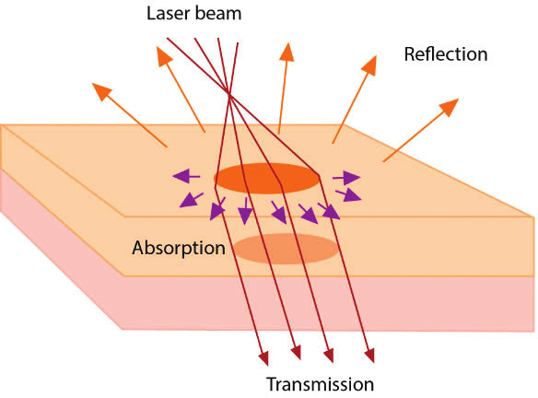
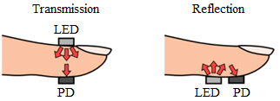
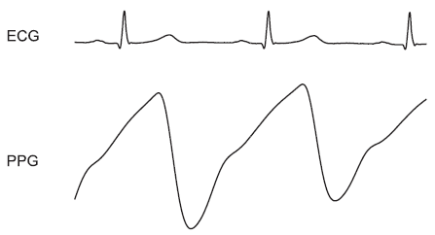
Pulsatile Wave
: Interaction of light with tissue waveform
Affected by the blood volume, blood vessel wall movement and the orientation of RBC
Scattering
?
Zahra et al. (2018). Oral Cancer - chapter Laser Dental Treatment Techniques.

Slide 4
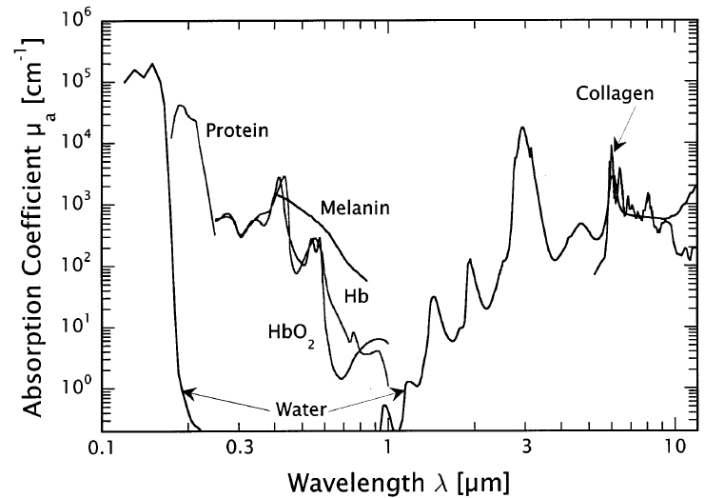
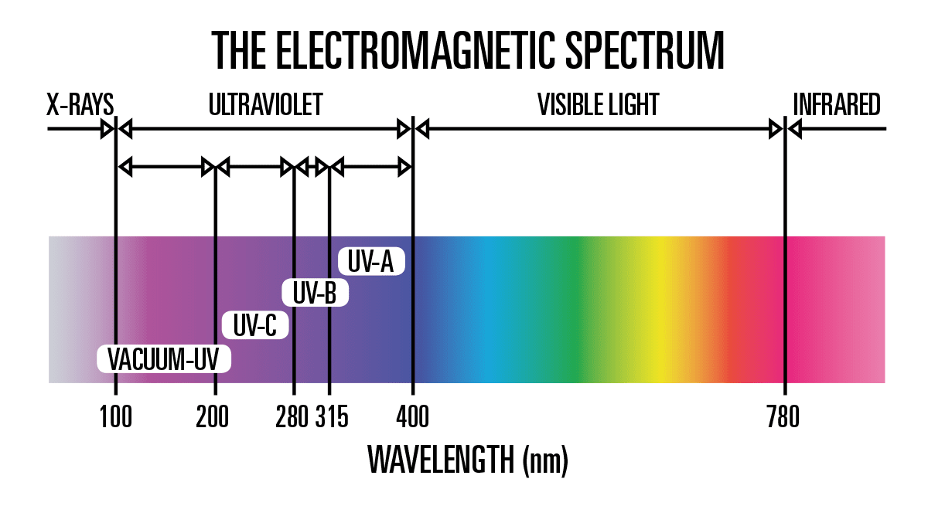
The Wavelength of Optical Radiation
Tissue penetration depth of light with different wavelengths
Optical absorption coefficients of principal tissue chromophores
Thus, the red or near infrared wavelengths are often chosen for the PPG light source.
Vogel A et al. Chem Rev. 2003 Feb;103(2):577-644.
Notes:
water: ultraviolet, longer infrared wavelength 잘 흡수; melanin: shorter wavelength 잘 흡수

Slide 5
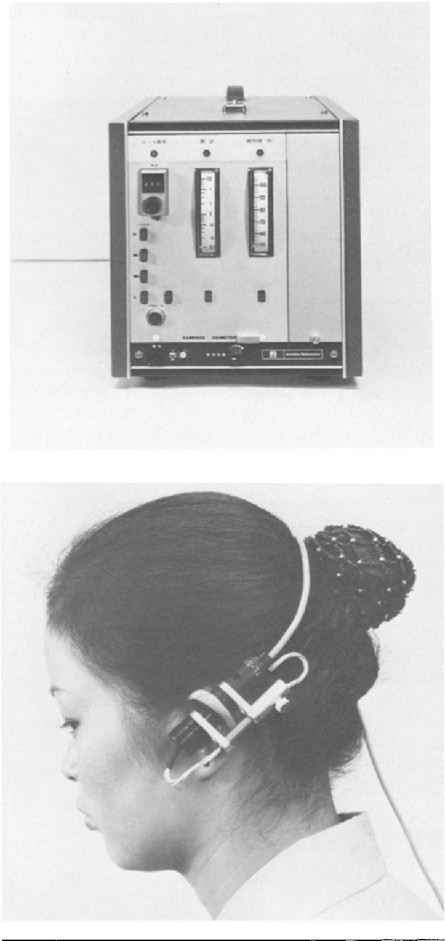
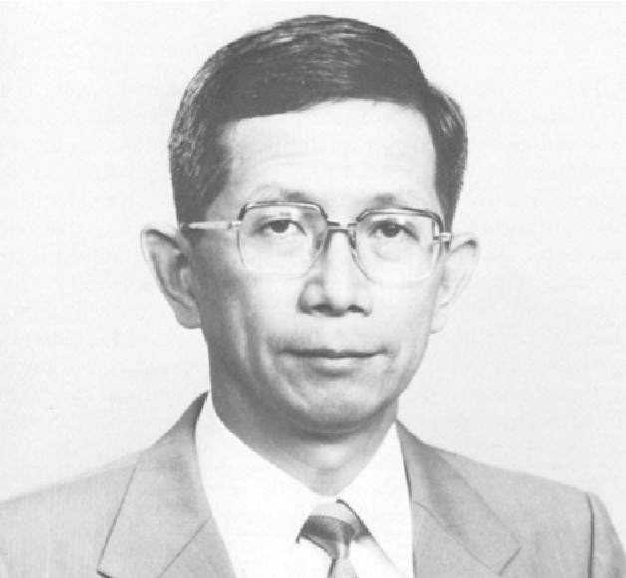
Early and Recent History of PPG
In 1936, Molitor and Kniazuk, Hanzlik et al, to monitor the blood volume changes in the rabbit ear
In 1937, Hertzman et al, to measure blood volume changes in the fingers using a battery powered torch bulb
In 1940, Hertzman and Dillon, split the AC and DC components
In 1974, Aoyagi et al, arterial oxygen saturation
In 1990, Duck, used low cost LED (CIE IR-A near infrared band 0.8 to 1 μm)

Slide 6
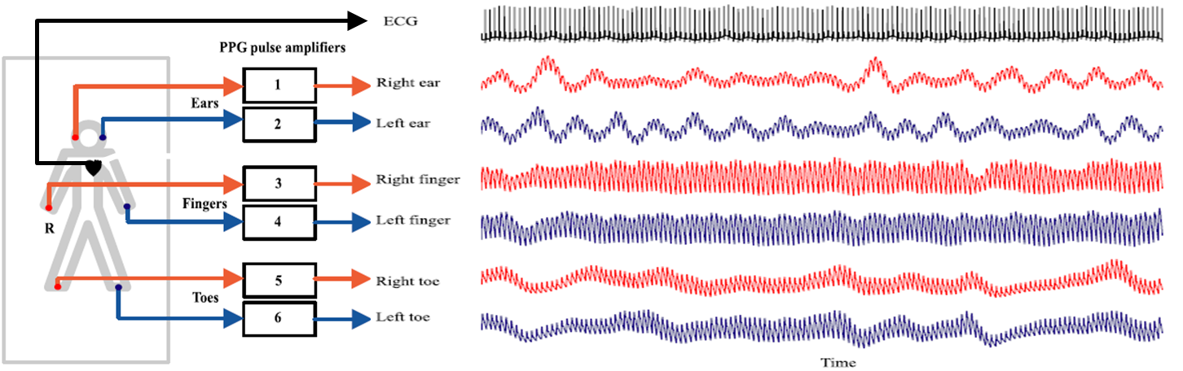
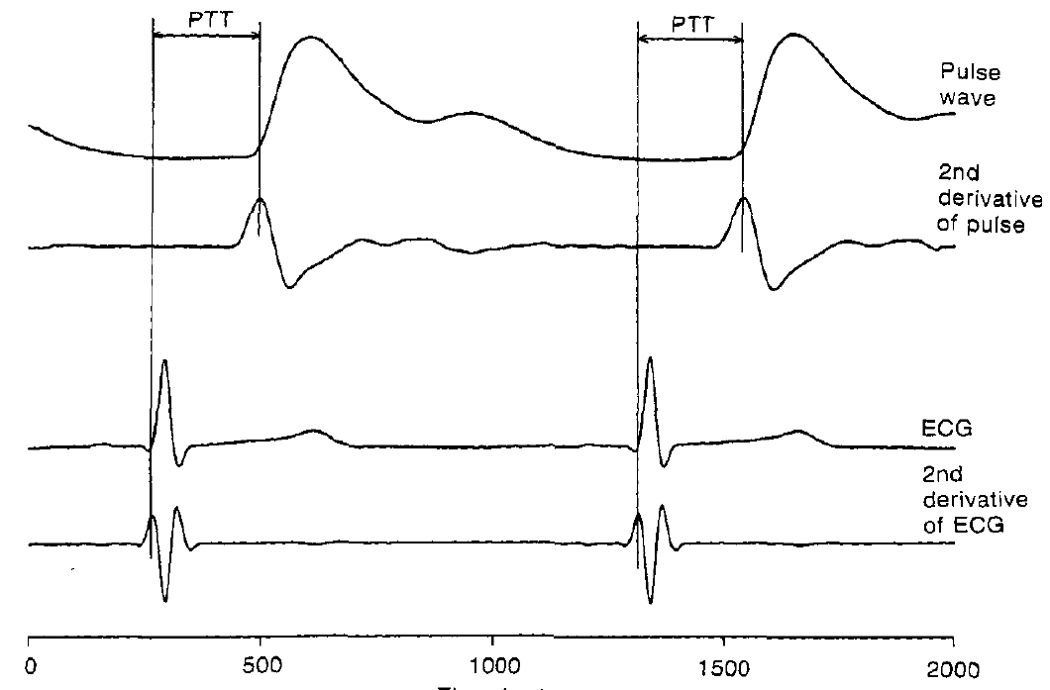
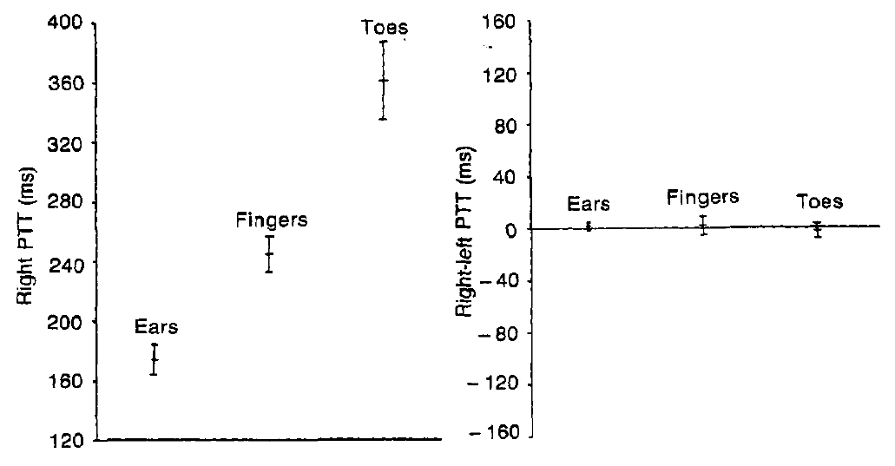
Body Sites for Measurement
There is similarity in the pulse characteristics between the right and left body sides but clear differences between the proximal and distal measurement sites.
Pulse transit time (PTT)
Pulse
wave
Right PTT (ms)
Right-Left PTT (ms)
Allen J et al. Measurement and Control. 2006;39(3):80-83.
Jago JR et al. Clin Phys Physiol Meas. 1988 Nov;9(4):319-30.

Slide 7
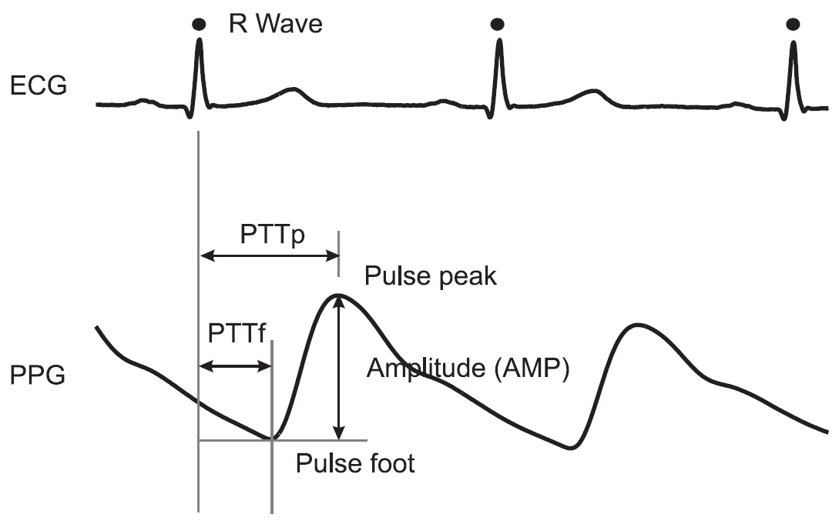
(AC) Pulse Wave Analysis
Systolic phase
Dicrotic notch
Diastolic phase
Murray WB et al. J Clin Monit. 1996 Sep;12(5):365-77.
Notes:
dicrotic notch: compliant artery

Slide 8
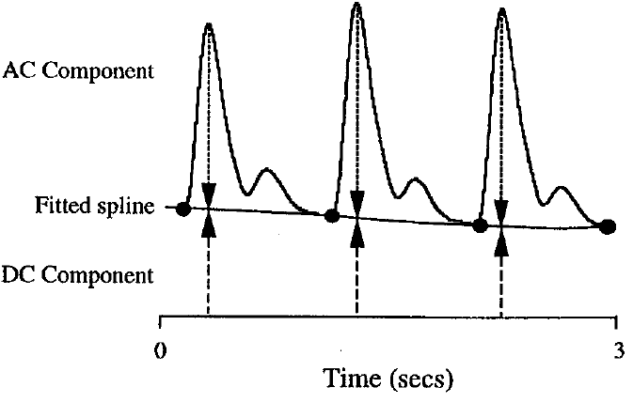
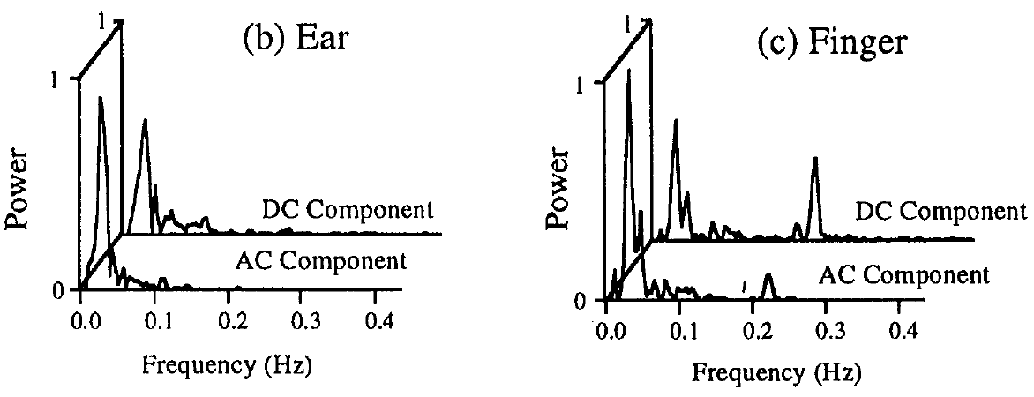
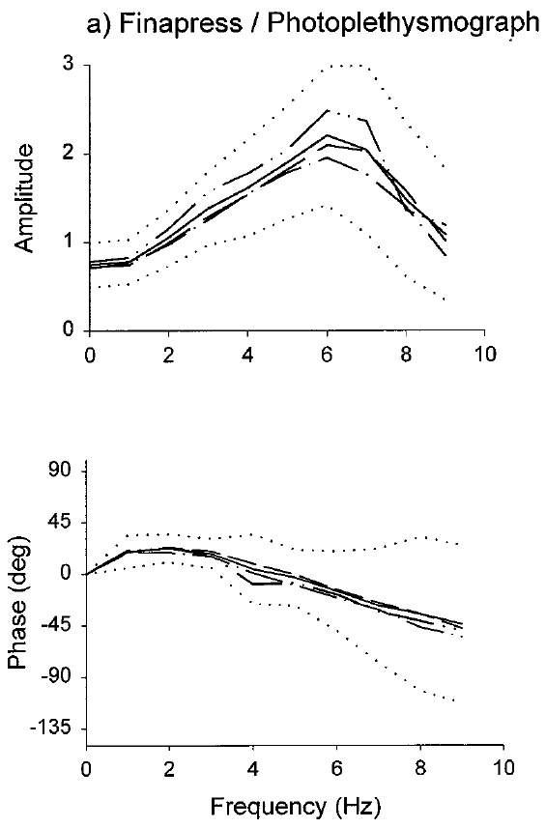
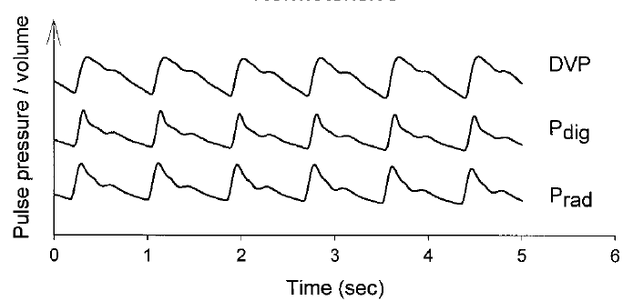
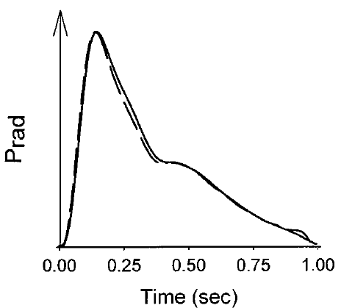
Pulse Wave Analysis
Analysis of Frequency (time domain, power spectrum)
No significant differences between the AC or DC signals or between the finger and the earlobe sites
Systems identification and transfer function modelling
  simulated pressure pulse from PPG vs. measured pressure pulses
Measured P wave
Predicted P wave from DVP wave
Fourier fx
(general transfer fx)
Larsen PD et al. Int J Clin Monit Comput. 1997;14(2):89-95.
Millasseau SC et al. Hypertension. 2000 Dec;36(6):952-6.

Slide 9
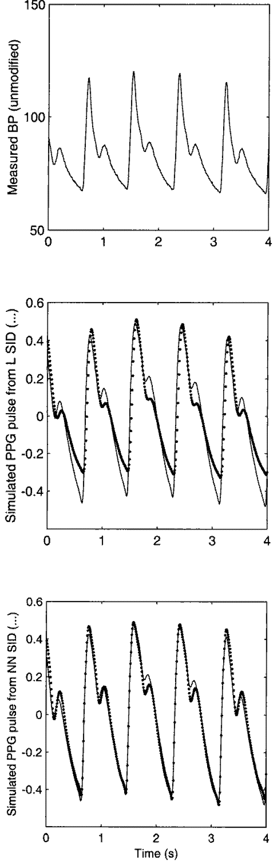
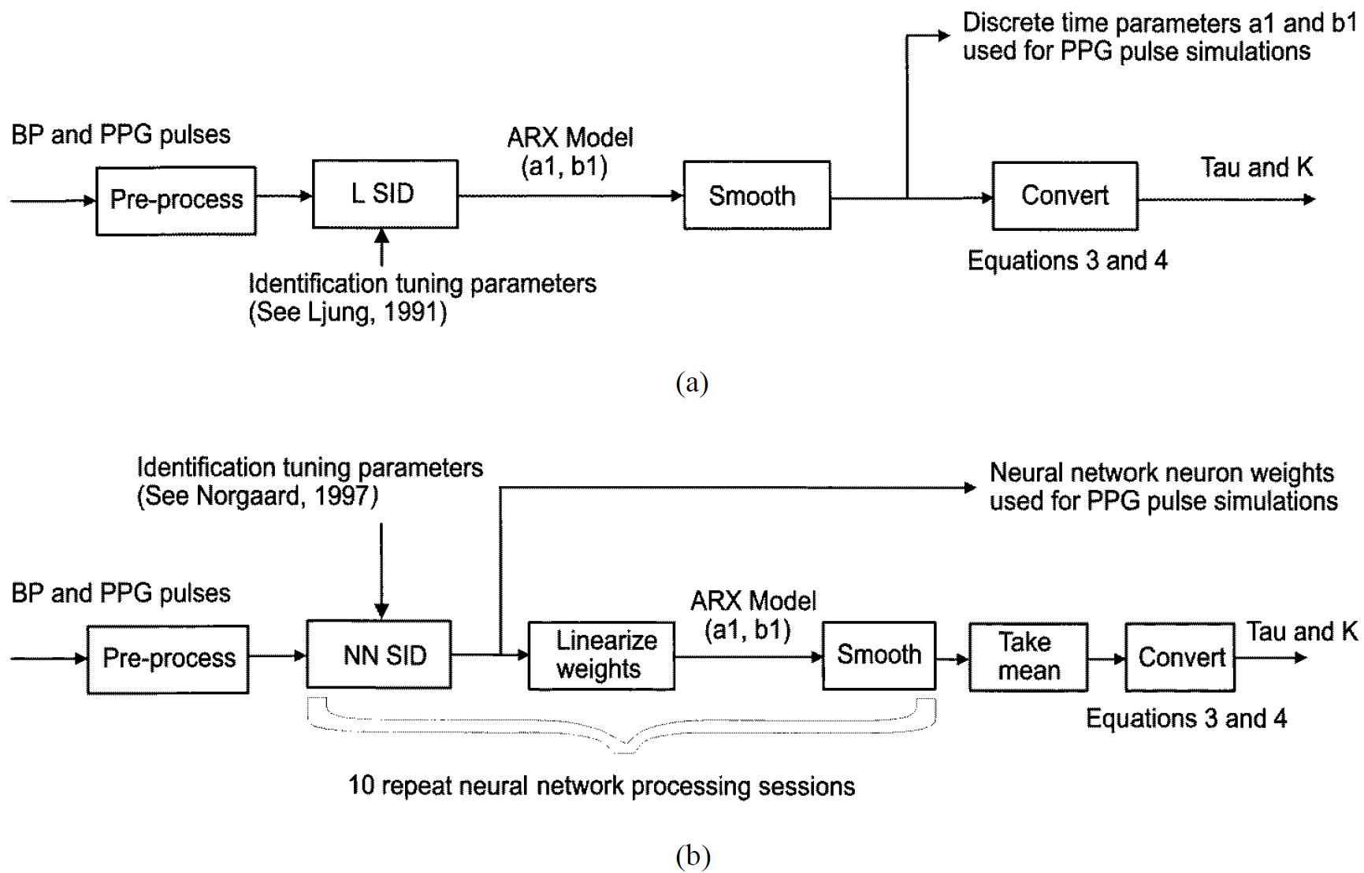
Pulse Wave Analysis
Artificial neural network analysis
  Simulated PPG for the peripheral vascular system (vs. simple linear algorithm)
Linear system identification algorithm
Neural network system identification algorithm
Allen J et al. Physiol Meas. 1999 Aug;20(3):287-301.
Notes:
blood pressure wave→ algorithm→ simulated blood volume wave, vs measured blood volume wave (PPG)

Slide 10
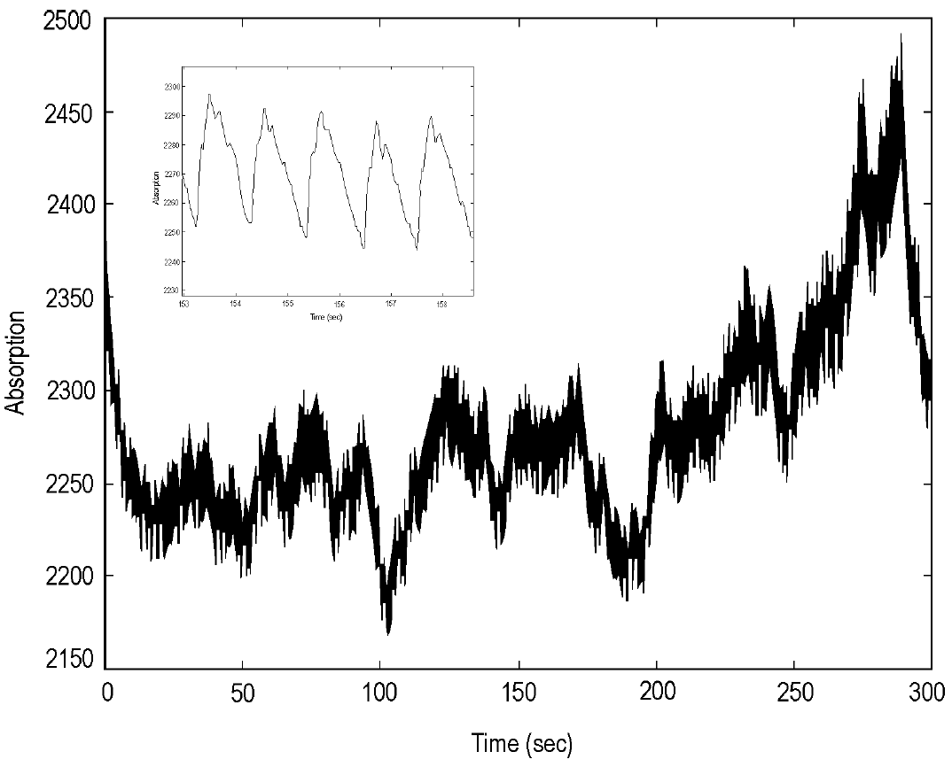
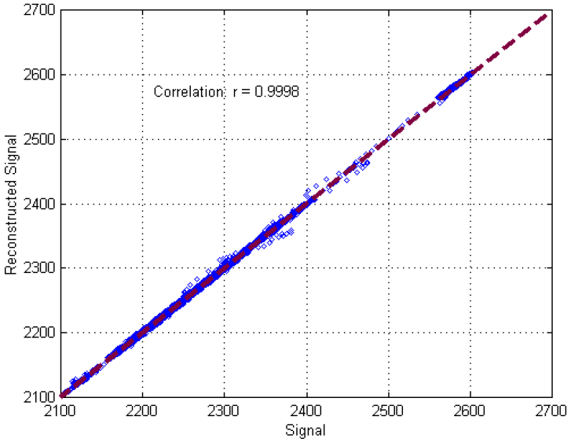
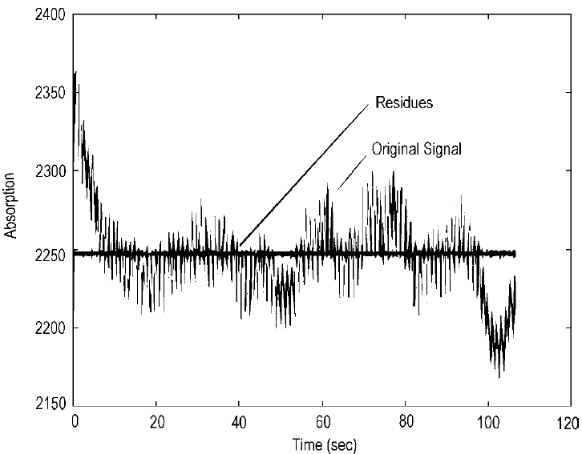
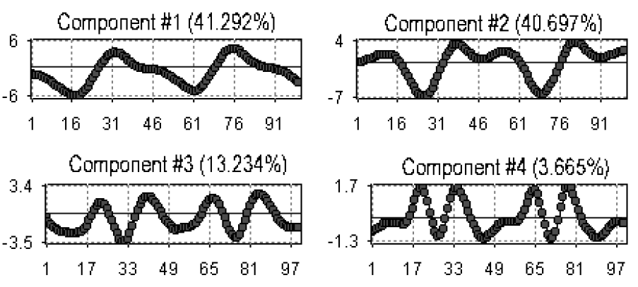
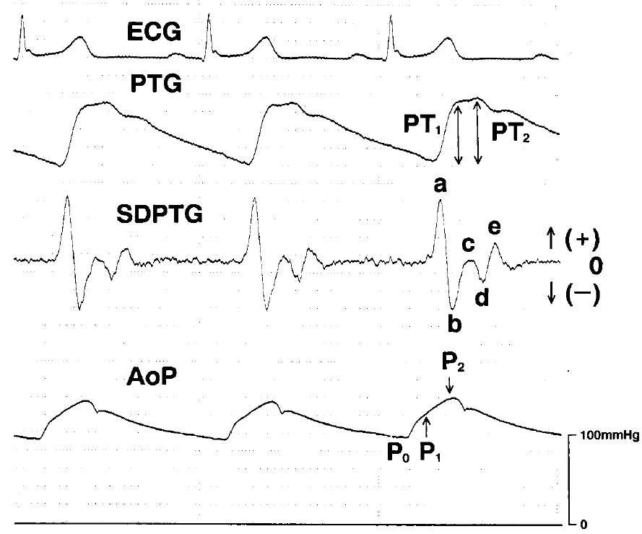
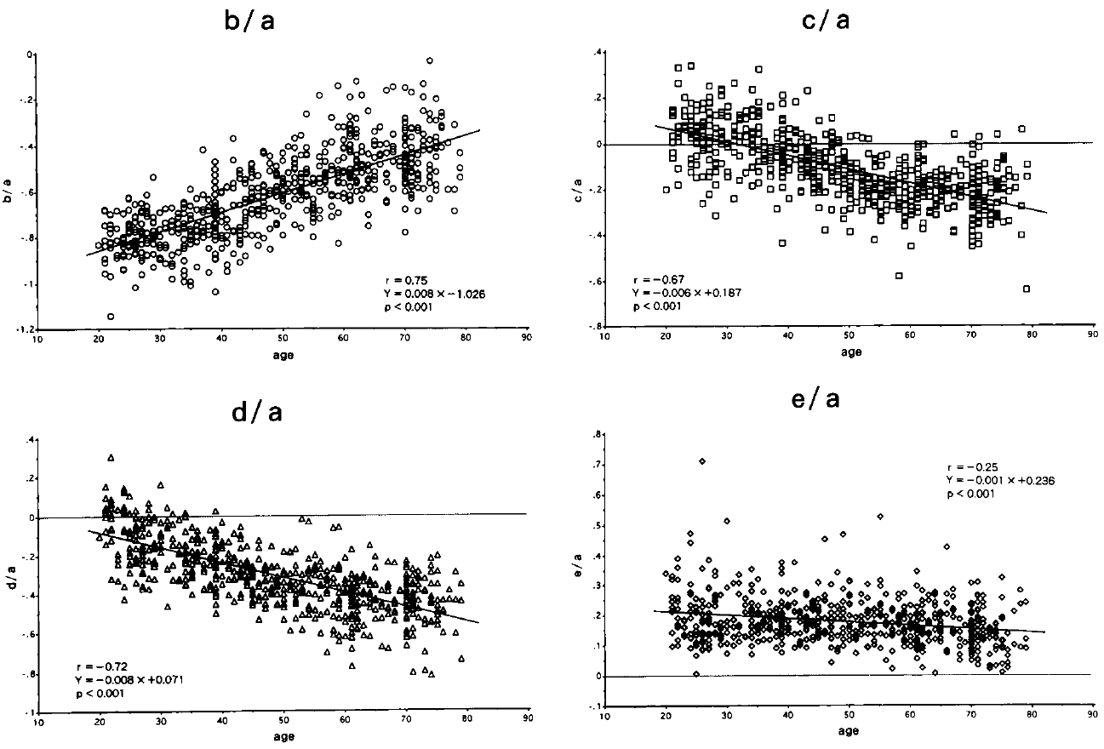
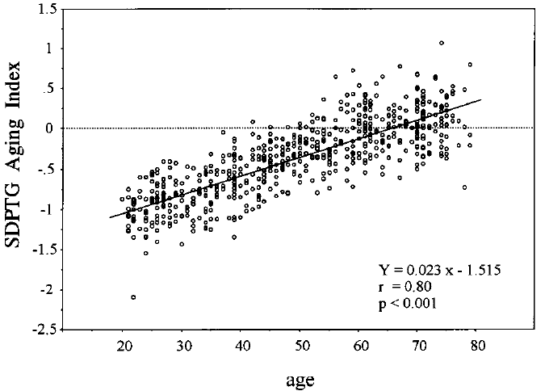
Pulse Wave Analysis
Principal component analysis (decomposing and regeneration)
Double differentiation (acceleration PPG)
Allen J et al. Physiol Meas. 2000 Aug;21(3):369-77.
Takazawa K et al. Hypertension. 1998 Aug;32(2):365-70.

Slide 11
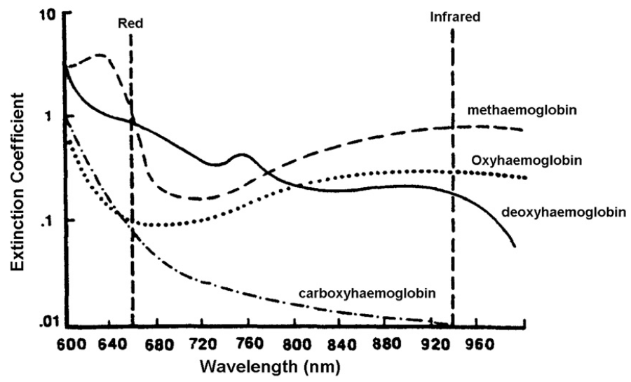
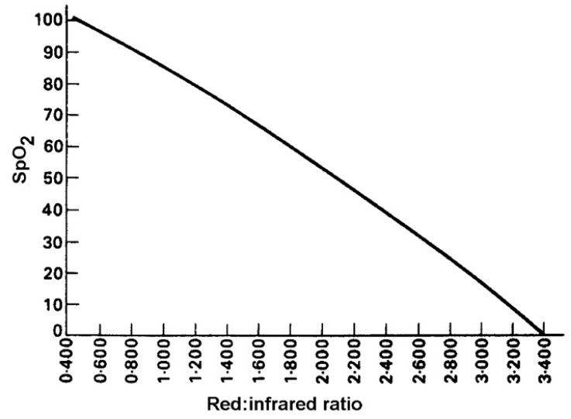
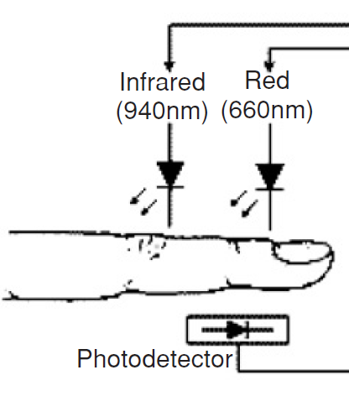
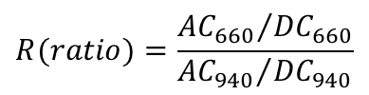
Clinical Applications
: Blood Oxygen Saturation
Absorption coefficient versus wavelength
Empirical relationship between arterial saturation and ‘red:infrared’ ratio
$$R(ratio)=\frac{{{AC}_{660}}/{{DC}_{660}}}{{{AC}_{940}}/{{DC}_{940}}}$$
Limitations: dyshaemoglobinaemias, decreased accuracy at low saturation levels, site temperature
Mannheimer PD et al. IEEE Trans Biomed Eng. 1997 Mar;44(3):148-58.

Slide 12
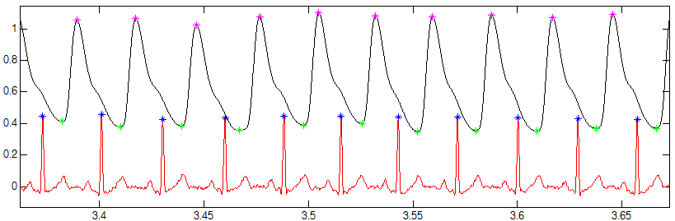
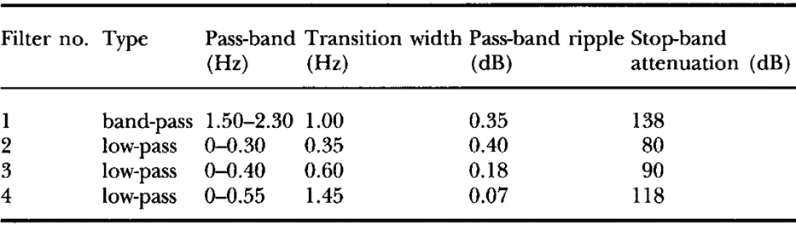
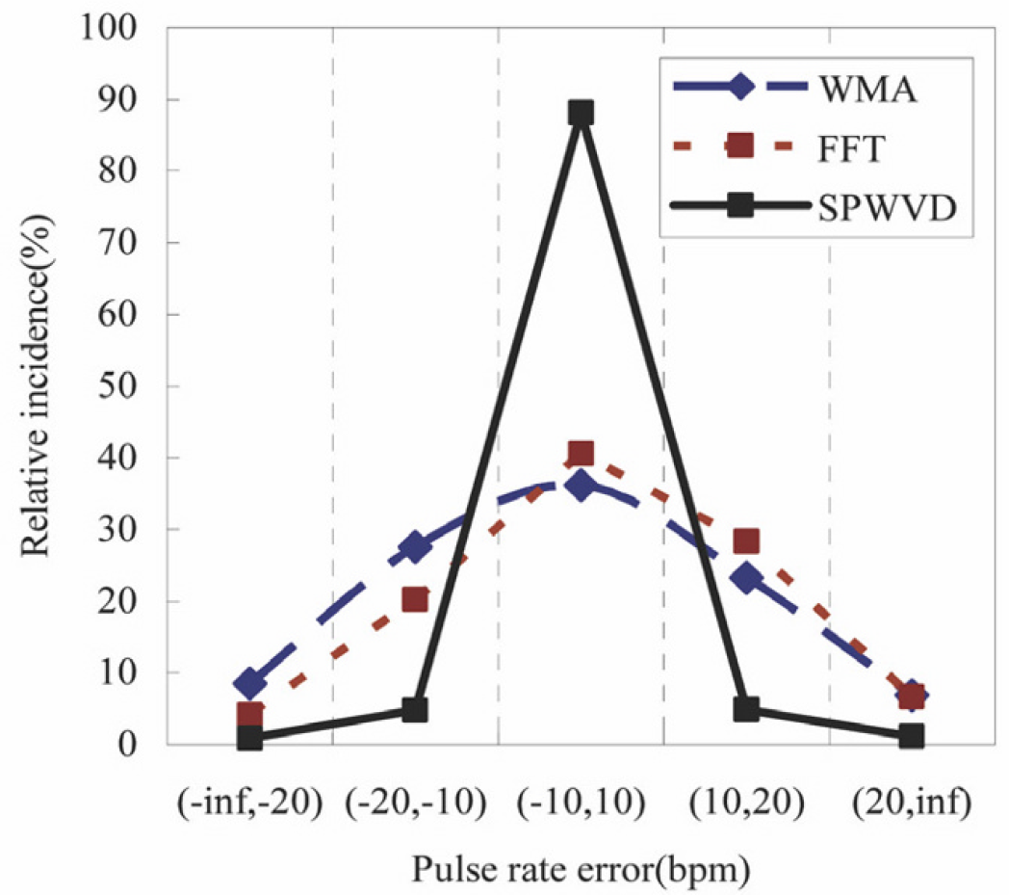
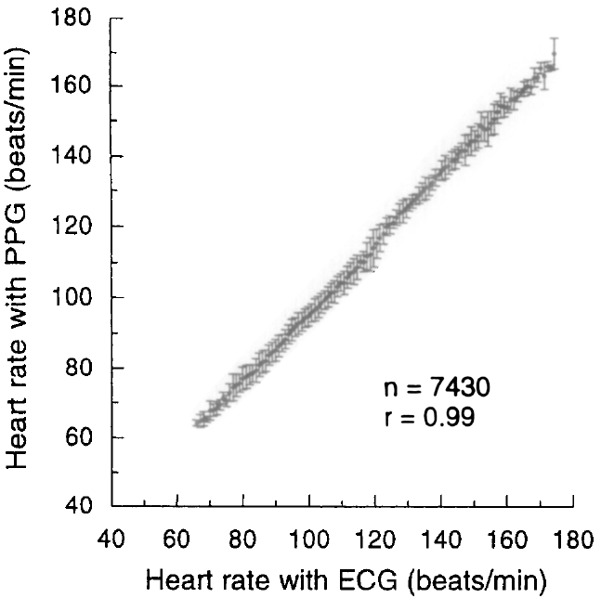
Clinical Applications
: Heart Rate
Cardiac arrhythmia
Movement artefact,
Simple digital filtering and zero crossing detection
Time-frequency techniques vs. traditional approaches
Weighted moving average (WMA); Fast Fourier transform (FFT); Smoothed psuedo Wigner-Ville distribution (SPWVD)
HR
Resp
Nakajima K et al. Med Eng Phys. 1996 Jul;18(5):365-72.
Yan YS et al. J Neuroeng Rehabil. 2005 Mar 1;2(1):3.

Slide 13
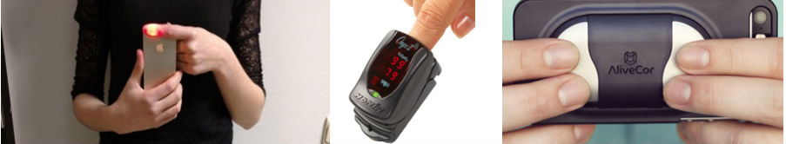
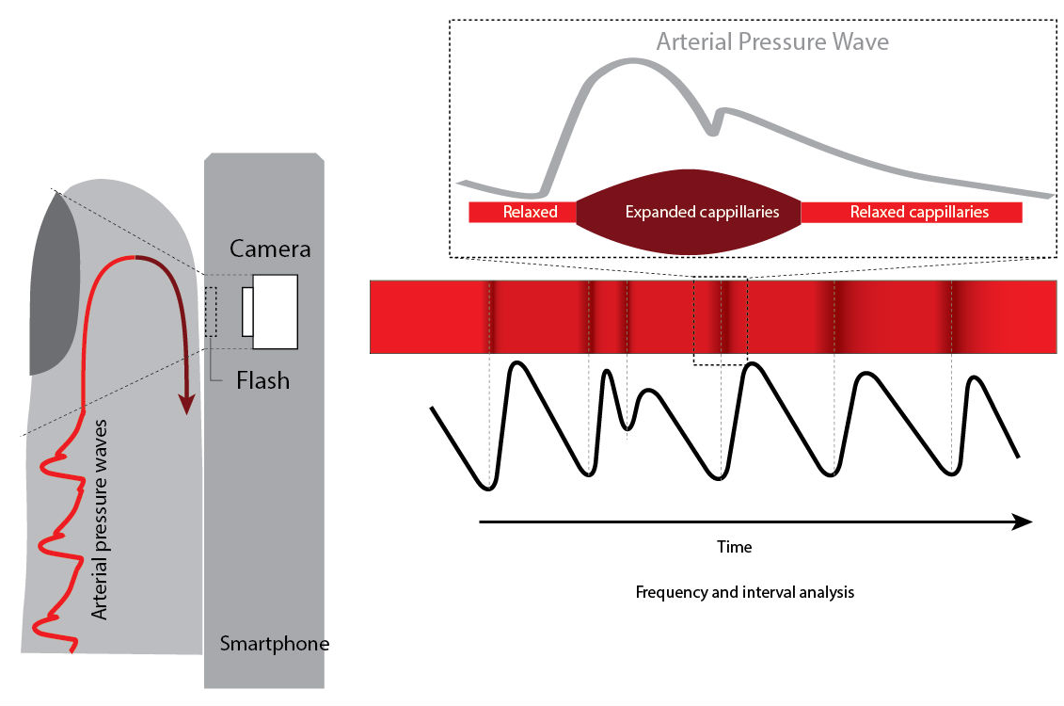
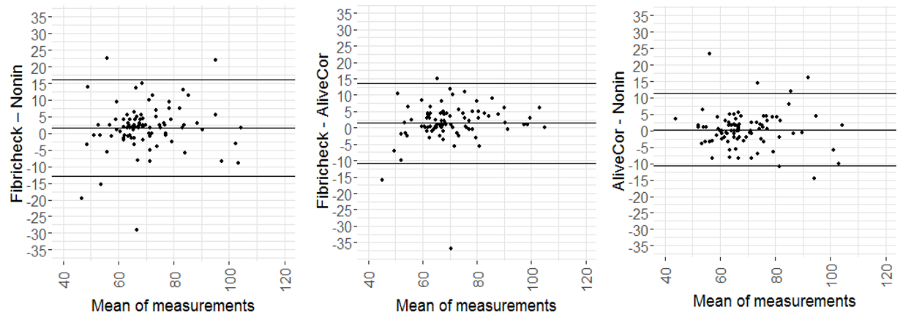
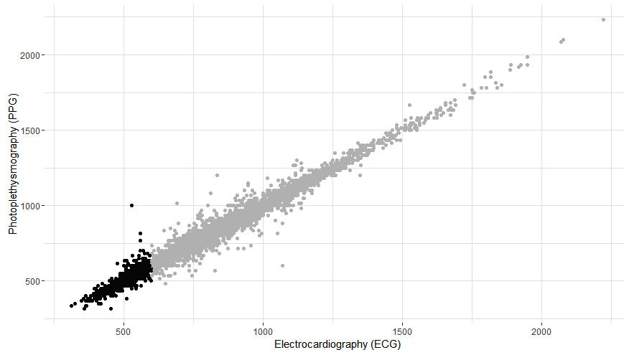
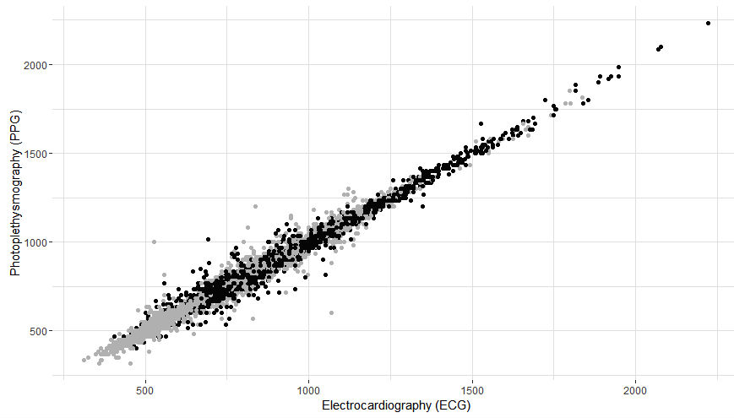
Arrhythmia Discrimination Using a Smart Phone
FibriCheck application
Nonin oximeter
AliveCor
mean bias=1.72 bpm
mean bias=1.42 bpm
mean bias=0.29 bpm
At high and low HR
In AF and non-AF
Vandenberk T et al. JMIR Mhealth Uhealth. 2017 Aug 25;5(8):e129.

Slide 14
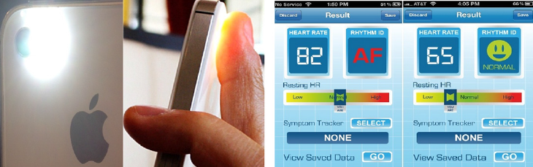
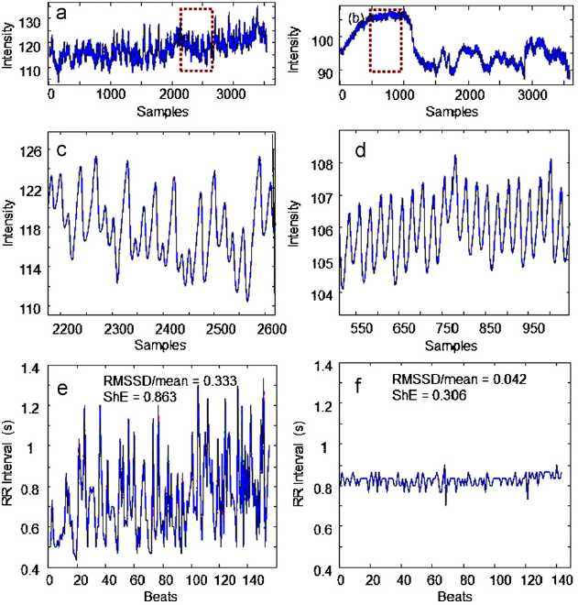


AF Detection
AF
SR
Pulse parameters before and after DCCV
 | AF | SR | P
RMSSD/mean | 0.29 (0.09) | 0.08 (0.08) | <.001
Shannon entropy | 0.80 (0.09) | 0.45 (0.13) | <.001
For the detection of AF in 76 patients with AF
 | Sensitivity | Specificity | Accuracy
RMSSD/mean | 0.9818 | 0.9150 | 0.9533
Shannon entropy | 0.9750 | 0.8218 | 0.9097
RMSSD/mean + Shannon entropy | 0.9619 | 0.9752 | 0.9676
McManus DD et al. Heart Rhythm. 2013 Mar;10(3):315-9.

Slide 15
Summary
The photoplethymography (PPG) of waveform consists of two parts, pulsatile part and steady part.
Pulsatile part indicates the change of blood volume.
PPG has been applied for various purposes, such as the measurement of heart rate, blood pressure, and cardiac output, the assessment of vascular condition, and the evaluation of sympathetic activity and heart rhythm.

